Slide 1
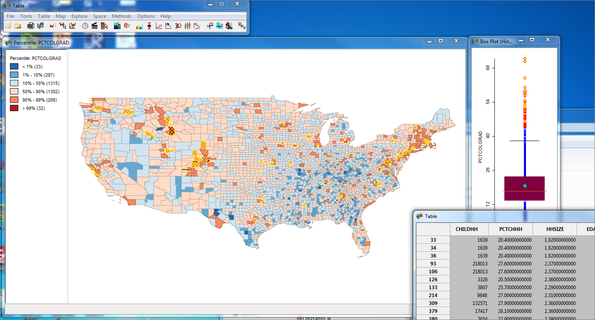
Exploratory Data Analysis

Slide 2
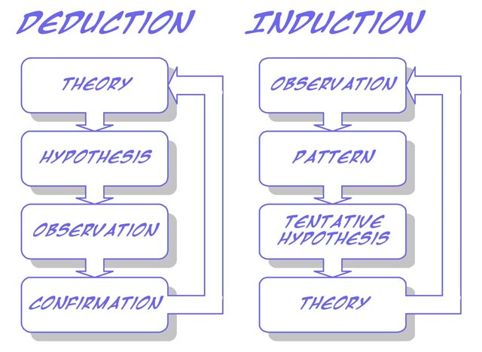
Revisiting models of statistical thinking
http://www.soes.soton.ac.uk
Notes:
Two models of statistical analysis.

Slide 3
Two models of statistical reasoning
Deductive/Hypothesis driven
Theory
Analysis
Hypothesis
Experiment
Notes:
Two models of statistical analysis.
The first is hypothesis driven, where a test is created specifically to test a specific hypothesis: neighborhood racial composition is a predictor of college degree attainment
Clear and focused, based on expanding existing research

Slide 4
Two models of statistical reasoning
2. Inductive/Exploratory Data Analysis
ESRI
Notes:
Exploratory data analysis is another alternative.
Particularly popular now working with large datasets.
Focus is on working with data and trying to visualize it in multiple ways. Look for patterns that appear in the data that may not be captured by standard statistical models.
Focus is on surprises within the data revealed through multiple passes through it.
May suggest more hypothesis driven experiments or highlight the need for better data.
Example from last time—”elbow” in the connection between HS and college graduation data.

Slide 5
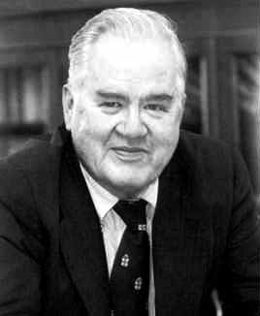
Inductive/Exploratory Data Analysis
John Tukey
“Numerical quantities focus on expected values, graphical summaries on unexpected values.”
Notes:
Exploratory data analysis is another alternative.
Particularly popular now working with large datasets.
Focus is on working with data and trying to visualize it in multiple ways. Look for patterns that appear in the data that may not be captured by standard statistical models.
Focus is on surprises within the data revealed through multiple passes through it.
May suggest more hypothesis driven experiments or highlight the need for better data.
Example from last time—”elbow” in the connection between HS and college graduation data.

Slide 6


Tukey encouraged the development of the S programming language at Bell Labs.
R is one descendent of this S software package.
Notes:
Exploratory data analysis is another alternative.
Particularly popular now working with large datasets.
Focus is on working with data and trying to visualize it in multiple ways. Look for patterns that appear in the data that may not be captured by standard statistical models.
Focus is on surprises within the data revealed through multiple passes through it.
May suggest more hypothesis driven experiments or highlight the need for better data.
Example from last time—”elbow” in the connection between HS and college graduation data.

Slide 7
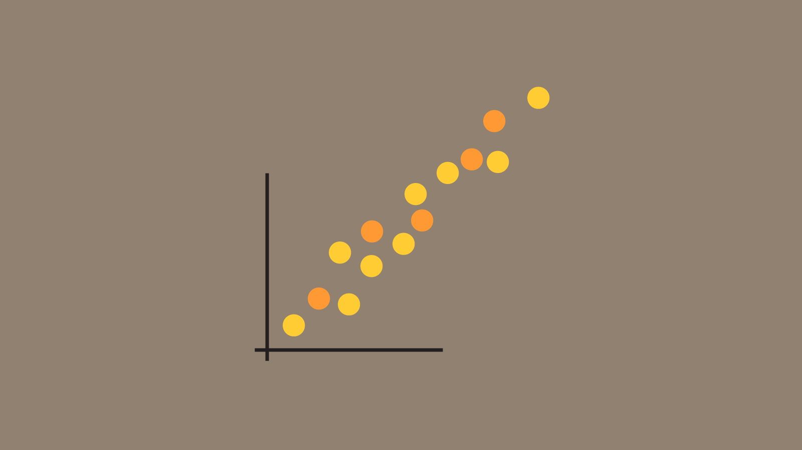
Ways to visualize data:
Scatterplots
http://www.datalabs.com.au/powerpoint-data-presentations/
Notes:
Exploratory data analysis is another alternative.
Particularly popular now working with large datasets.
Focus is on working with data and trying to visualize it in multiple ways. Look for patterns that appear in the data that may not be captured by standard statistical models.
Focus is on surprises within the data revealed through multiple passes through it.
May suggest more hypothesis driven experiments or highlight the need for better data.
Example from last time—”elbow” in the connection between HS and college graduation data.

Slide 8
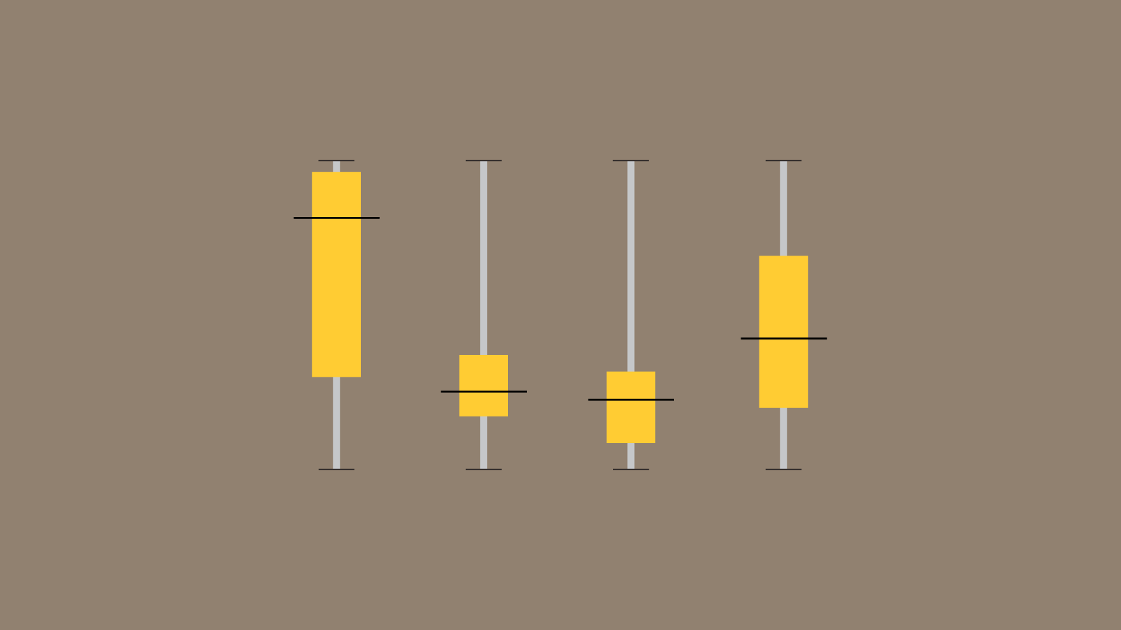
Ways to visualize data:
Boxplots
http://www.datalabs.com.au/powerpoint-data-presentations/
Notes:
Exploratory data analysis is another alternative.
Particularly popular now working with large datasets.
Focus is on working with data and trying to visualize it in multiple ways. Look for patterns that appear in the data that may not be captured by standard statistical models.
Focus is on surprises within the data revealed through multiple passes through it.
May suggest more hypothesis driven experiments or highlight the need for better data.
Example from last time—”elbow” in the connection between HS and college graduation data.

Slide 9
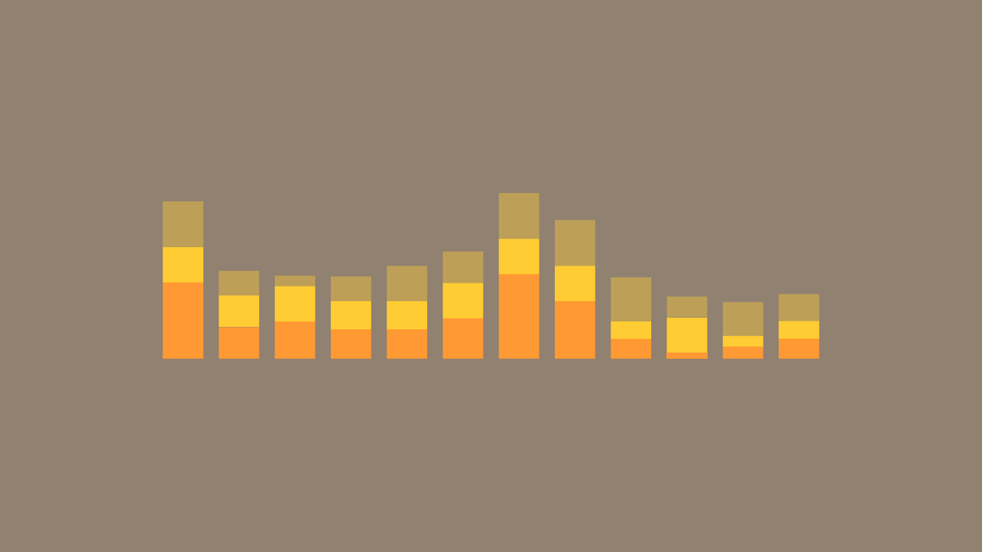
Ways to visualize data:
Bar charts/histograms
http://www.datalabs.com.au/powerpoint-data-presentations/
Notes:
Exploratory data analysis is another alternative.
Particularly popular now working with large datasets.
Focus is on working with data and trying to visualize it in multiple ways. Look for patterns that appear in the data that may not be captured by standard statistical models.
Focus is on surprises within the data revealed through multiple passes through it.
May suggest more hypothesis driven experiments or highlight the need for better data.
Example from last time—”elbow” in the connection between HS and college graduation data.

Slide 10
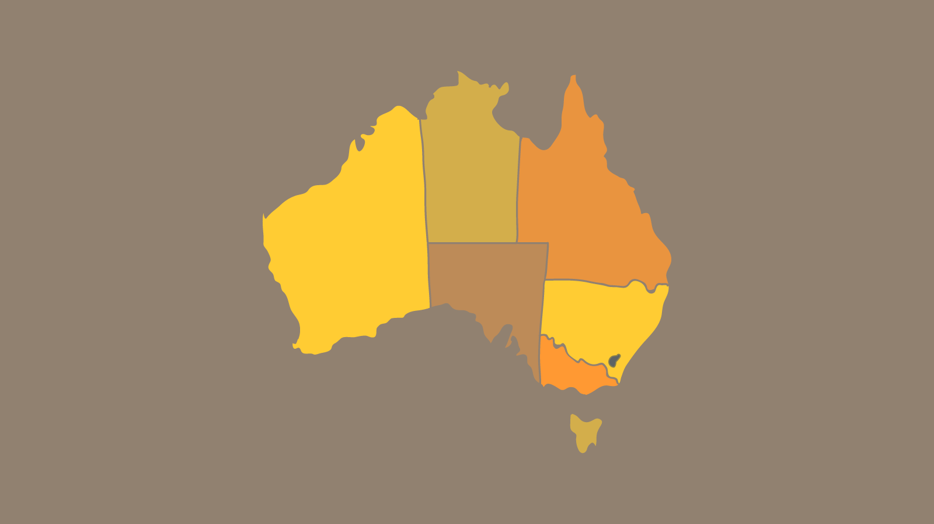
Ways to visualize data:
Choropleth maps
http://www.datalabs.com.au/powerpoint-data-presentations/
Notes:
Exploratory data analysis is another alternative.
Particularly popular now working with large datasets.
Focus is on working with data and trying to visualize it in multiple ways. Look for patterns that appear in the data that may not be captured by standard statistical models.
Focus is on surprises within the data revealed through multiple passes through it.
May suggest more hypothesis driven experiments or highlight the need for better data.
Example from last time—”elbow” in the connection between HS and college graduation data.

Slide 11
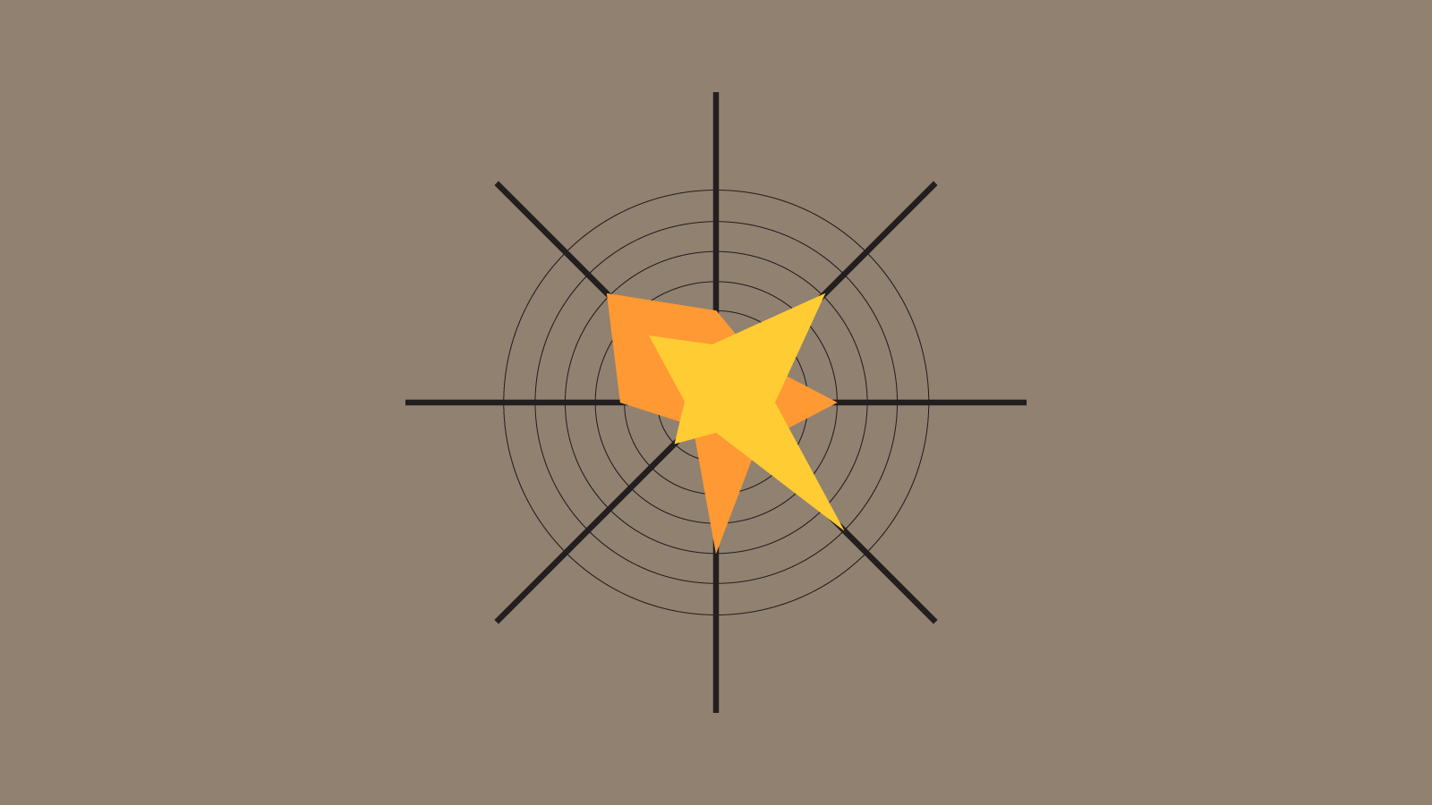
Ways to visualize data:
Star plot/radar plot
http://www.datalabs.com.au/powerpoint-data-presentations/
Notes:
Exploratory data analysis is another alternative.
Particularly popular now working with large datasets.
Focus is on working with data and trying to visualize it in multiple ways. Look for patterns that appear in the data that may not be captured by standard statistical models.
Focus is on surprises within the data revealed through multiple passes through it.
May suggest more hypothesis driven experiments or highlight the need for better data.
Example from last time—”elbow” in the connection between HS and college graduation data.

Slide 12
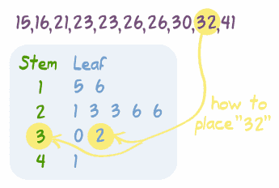
Ways to visualize data:
Stem and leaf plots
http://www.datalabs.com.au/powerpoint-data-presentations/
Notes:
Exploratory data analysis is another alternative.
Particularly popular now working with large datasets.
Focus is on working with data and trying to visualize it in multiple ways. Look for patterns that appear in the data that may not be captured by standard statistical models.
Focus is on surprises within the data revealed through multiple passes through it.
May suggest more hypothesis driven experiments or highlight the need for better data.
Example from last time—”elbow” in the connection between HS and college graduation data.

Slide 13
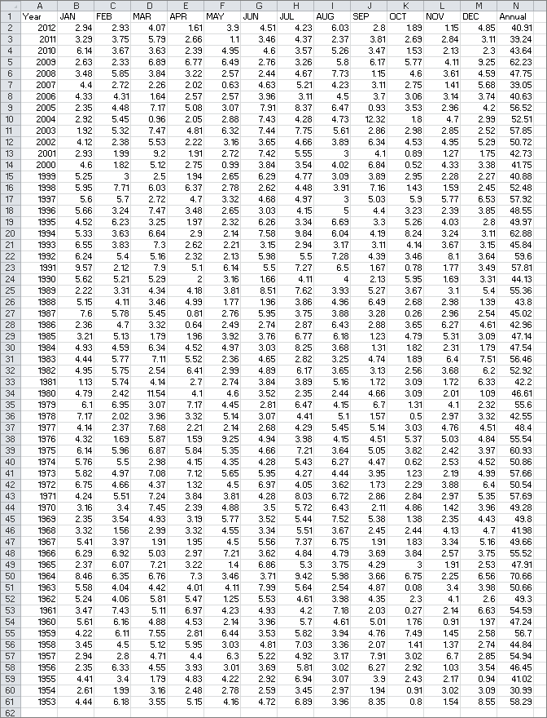
Data Exploration
Annual Rainfall for Georgia, 1953-2012

Slide 14
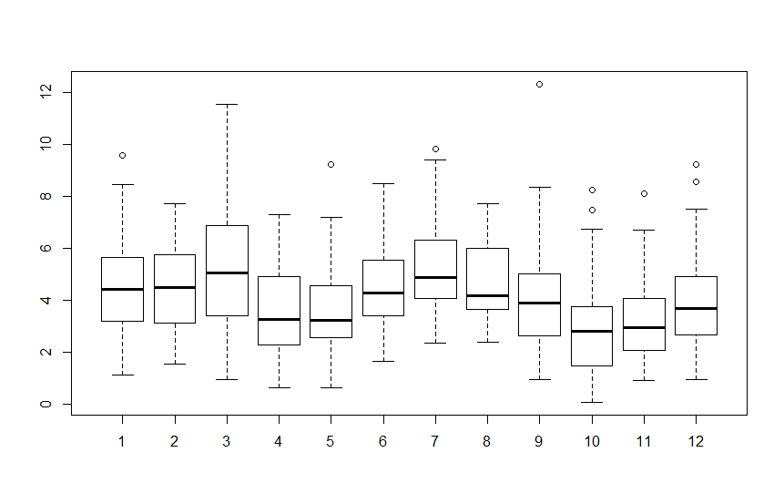
Data Exploration
Boxplot of data-What do you notice?

Slide 15
Data Exploration
Difference between March and September?

Slide 16
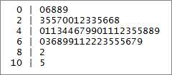
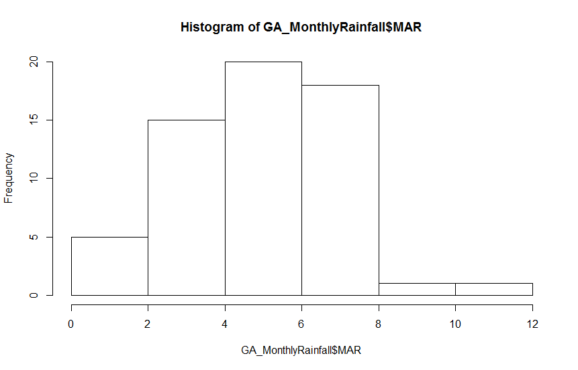
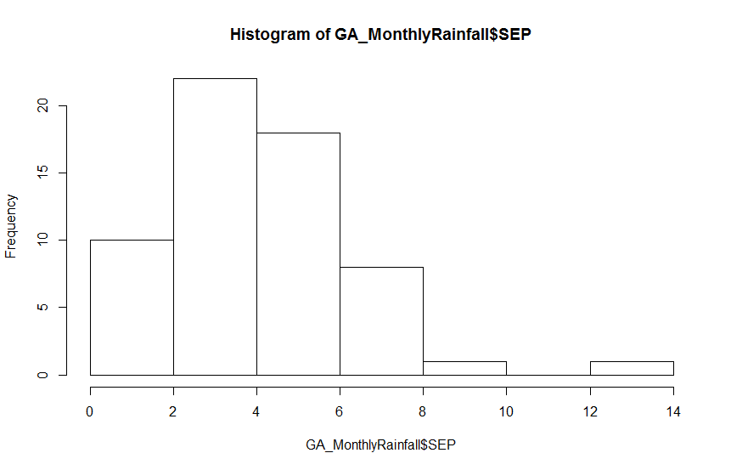
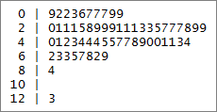
Data Exploration
Stem and leaf charts, histograms
March
September

Slide 17
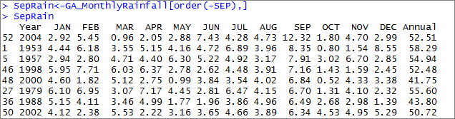
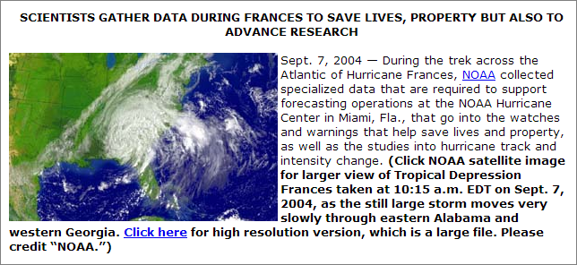
Data Exploration
Which year?
http://www.noaanews.noaa.gov/stories2004/s2316.htm
Notes:
Where could we go at this point? Depends on what we’re interested in.
Could cut out this outlier month from the analysis if you’re interested in “normal” weather patterns
Or could be start of a project on how hurricanes affect weather data (and weather) in the region. Or how ecosystems respond differently to outlier events to regular ones (wet March vs. Sept. hurricane).
Important part of this: we didn’t start out with a theory we wanted to test. Rather, we started with data which led to questions. Different kind of process.

Slide 18
The GeoDa software package also encourages EDA.
Notes:
Where could we go at this point? Depends on what we’re interested in.
Could cut out this outlier month from the analysis if you’re interested in “normal” weather patterns
Or could be start of a project on how hurricanes affect weather data (and weather) in the region. Or how ecosystems respond differently to outlier events to regular ones (wet March vs. Sept. hurricane).
Important part of this: we didn’t start out with a theory we wanted to test. Rather, we started with data which led to questions. Different kind of process.

Slide 19
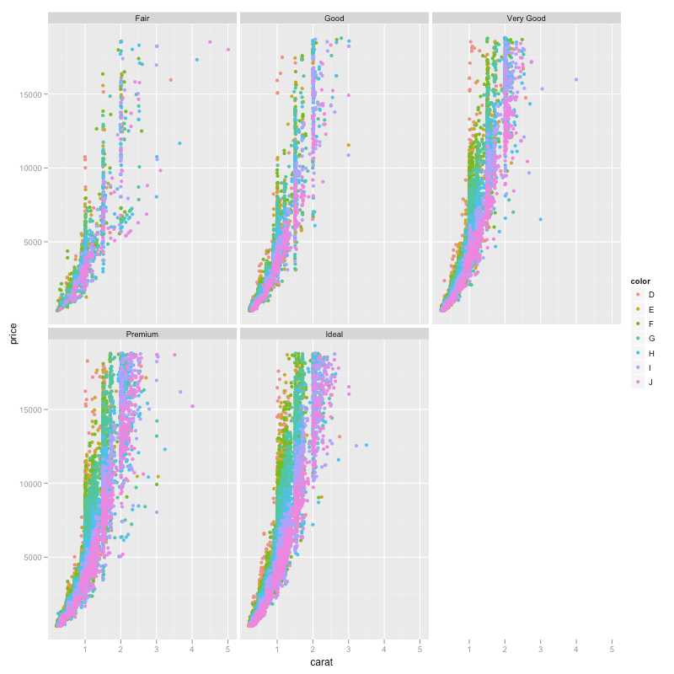
ggplot2: visualization package in R
Notes:
Where could we go at this point? Depends on what we’re interested in.
Could cut out this outlier month from the analysis if you’re interested in “normal” weather patterns
Or could be start of a project on how hurricanes affect weather data (and weather) in the region. Or how ecosystems respond differently to outlier events to regular ones (wet March vs. Sept. hurricane).
Important part of this: we didn’t start out with a theory we wanted to test. Rather, we started with data which led to questions. Different kind of process.

